Slide 1
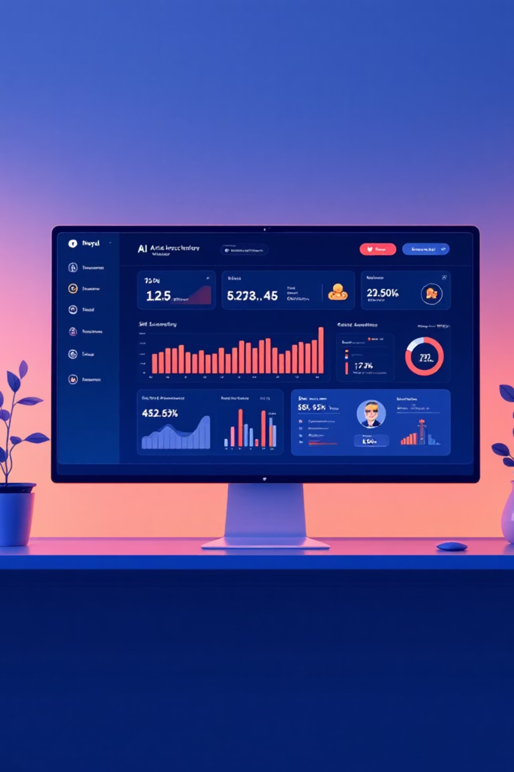
AI skill gap Analyzer
Priya Poosaala
priyapoosaala@gmail.com
.

Slide 2

Project Overview
The AI Skill Gap Analyzer is a web-based system that automates the extraction, analysis, and visualization of both technical and soft skills from resumes and job descriptions.
It helps recruiters and learners identify skill gaps, analyze skill trends, and support data-driven hiring and training decisions through an interactive Streamlit interface.
=

Slide 3
Project Objectives
Automate skill extraction from resumes or job descriptions.
Perform semantic skill similarity using BERT embeddings.
Provide interactive skill visualizations (Pie, Bar, similarity matrix).
Export reports in CSV, JSON, or text.
Offer a real-time interactive Streamlit UI.

Slide 4
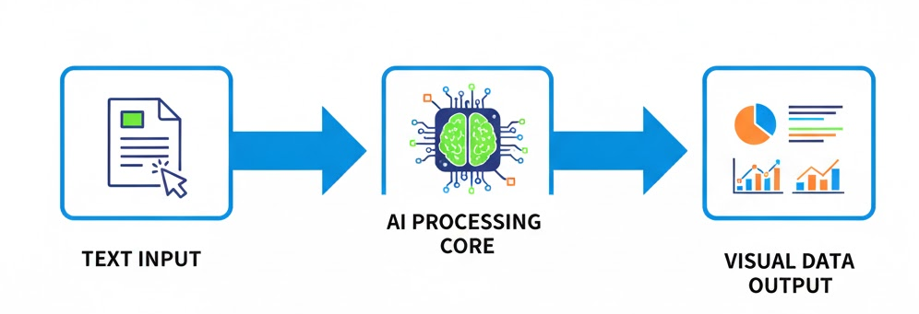
Project Architecture Overview
Flow:
Input (Text/PDF) → Layer 1: Robust Extraction → Layer 2: Semantic Analysis (BERT) → Output: Data & Visuals.

Slide 5

Workflow in Action
The web app guides users through a structured workflow:
Skill Extraction: Detects skills using multiple linguistic and contextual methods.
Skill Embedding: Generates BERT-based vectors for skill similarity.
Visualization Dashboard: Explore insights with charts and tables.
Result Export: Download structured reports in various formats.

Slide 6

Behind the Architecture
The project is structured into modular components:
•• DocumentProcessor – Extracts and preprocesses text from uploaded resumes and job descriptions (PDF, DOCX, TXT). • SkillDatabase – Stores predefined skill categories and keyword patterns used for extraction. • SkillExtractor – Identifies technical and soft skills using multiple extraction techniques (keyword, semantic, statistical). • SentenceBERTEncoder – Generates contextual embeddings using Sentence-BERT for semantic similarity analysis. • SimilarityCalculator – Computes cosine similarity between resume and job description skill vectors. • SkillGapAnalyzer – Determines matched, partially matched, and missing skills based on similarity thresholds. • GapVisualizer – Creates interactive visualizations such as heatmaps, pie charts, and bar graphs. • ReportGenerator – Produces downloadable summary reports in text, CSV, or JSON format. • LearningPathGenerator – Builds personalized learning recommendations based on missing skills. • Main Streamlit App – Integrates all components, manages user interaction, navigation, and session state.

Slide 7
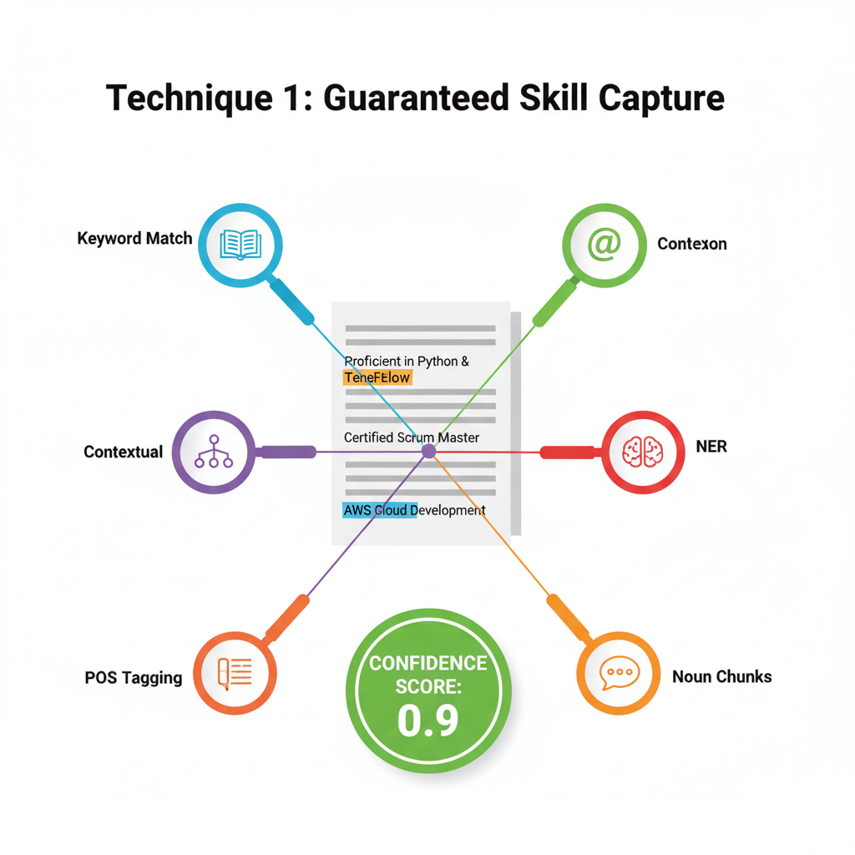
Semantic Analysis with BERT 💡
Challenge: Rule-based systems cannot grasp the relationship between "Keras" (a framework) and "Deep Learning" (a concept).
Solution: Sentence-BERT: We map every skill to a high-dimensional vector space.
Mechanism: SBERT ensures that skills with similar meanings, like Kubernetes and K8s, are placed close together. This allows us to search for related concepts, not just exact words. Visual: A visual representation of vector embeddings or a graphic of two related words connected by a high similarity score.

Slide 8

The App Interface (Streamlit) 🖥️
The Interactive Dashboard Experience
The entire project is packaged in a user-friendly Streamlit web app.
Input Handling: Supports Text Pasting and File Upload
Navigation: The use of tabs cleanly separates the workflow: Extraction,Analysis, Visualizations,Score.

Slide 9

Analysis
SkillVisualizer
Purpose: Visualize results
Charts Used:
✅ Pie Chart
Bar graph
heatmap
Bargraph
Library: The Python library used for generating the diagrams (charts and graphs) in your Streamlit application code is Plotly plotly.graph_objects

Slide 10
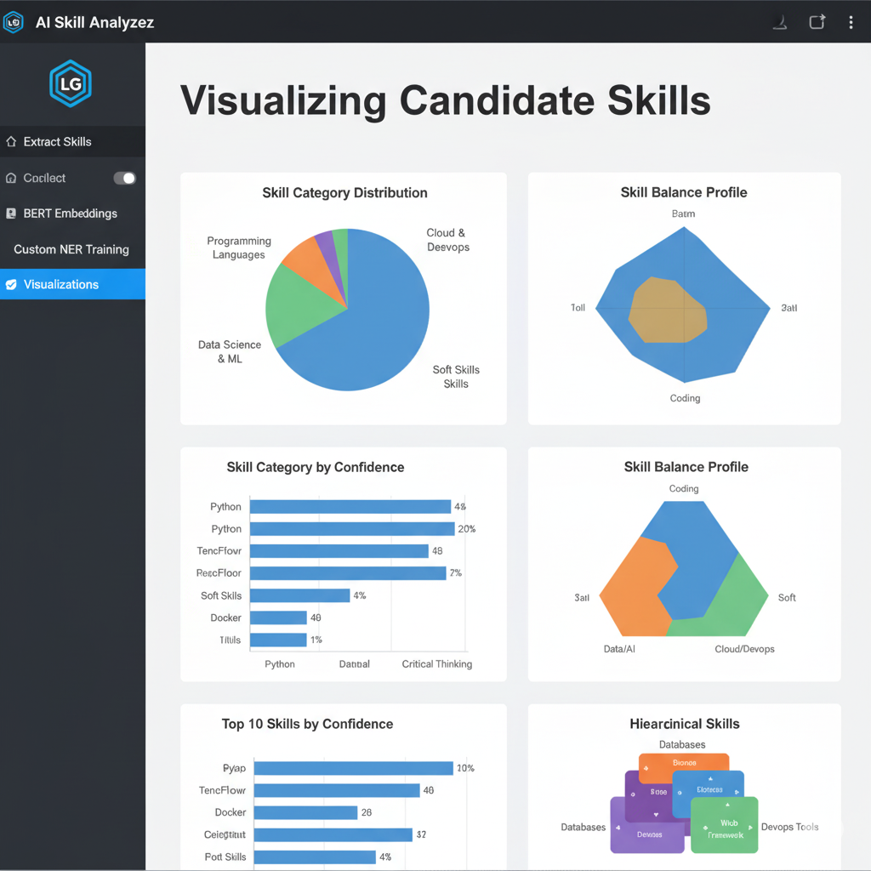
Horizontal Bar Chart of Top N Skills by Confidence Score.
Visualization
Visualization: Pie Chart showing the percentage breakdown of all extracted skills by major categories (Languages, Databases, Cloud, etc.).

Slide 11
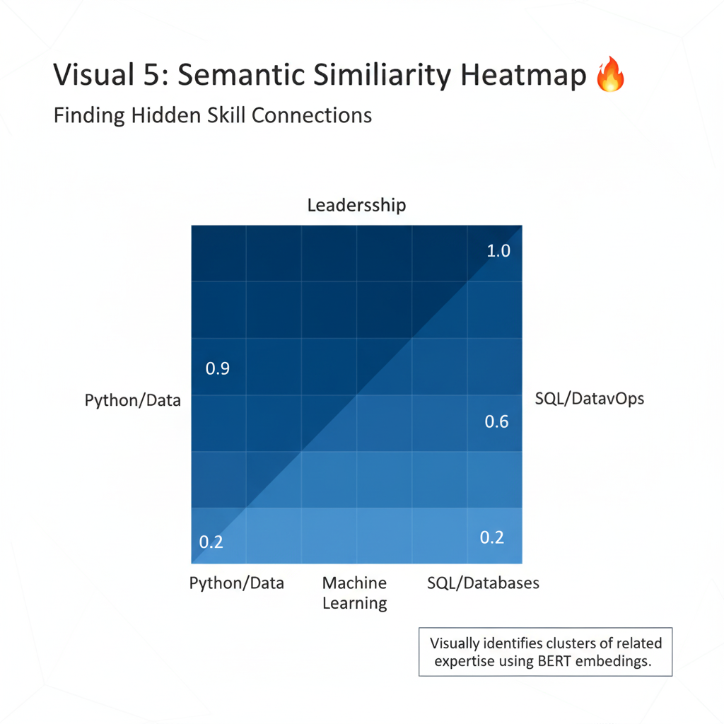
Similarity Matrix Heatmap
Finding Hidden Skill Connections
Visualization: A Heatmap showing how closely related the top N skills are to each other.
Data Source: This uses the BERT vectors.
Insight: Highlights clusters of expertise. For example, dark squares show strong ties between "Machine Learning" and "Python," validating the profile's core domain

Slide 12
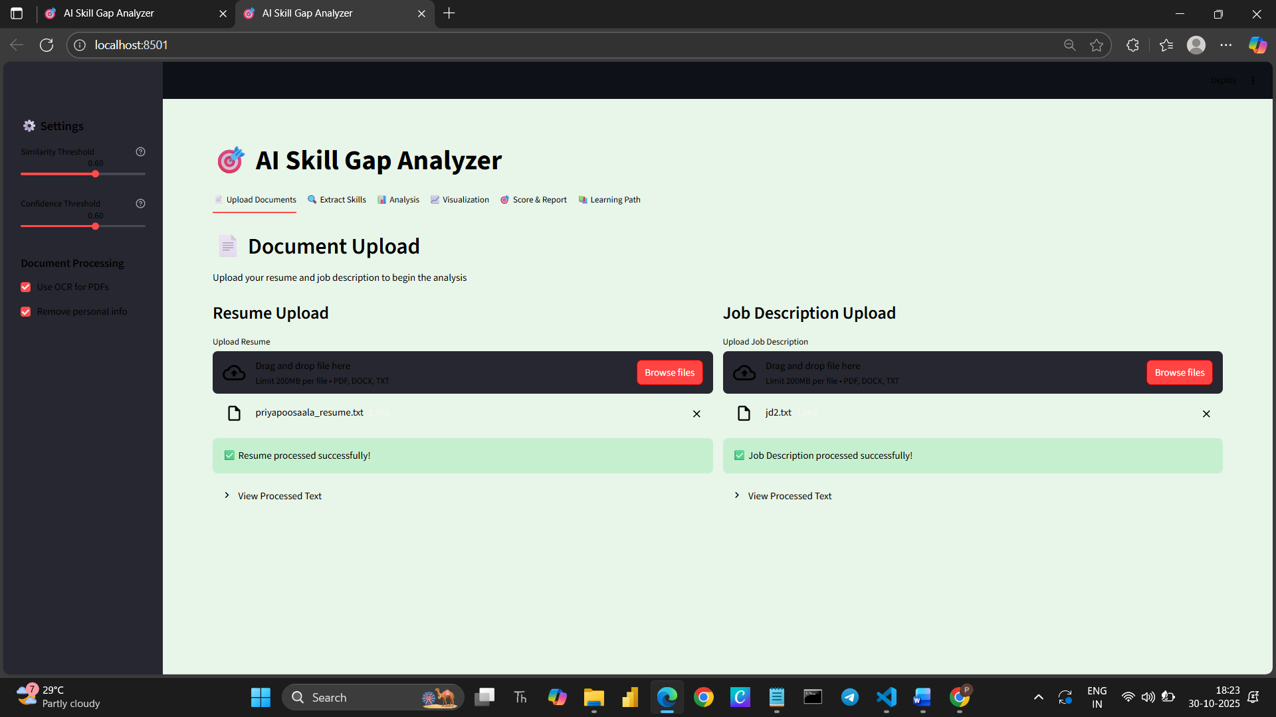
snapshots

Slide 13
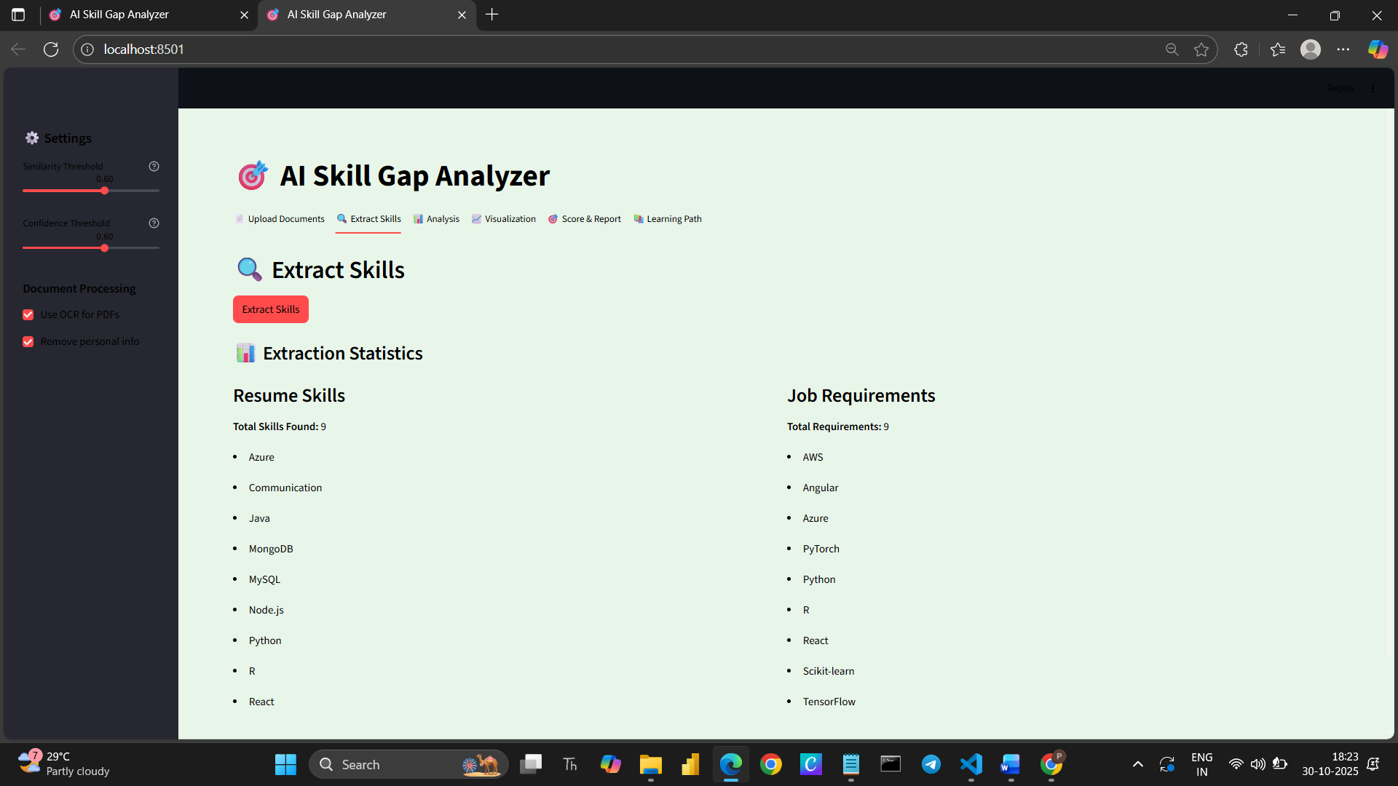

Slide 14
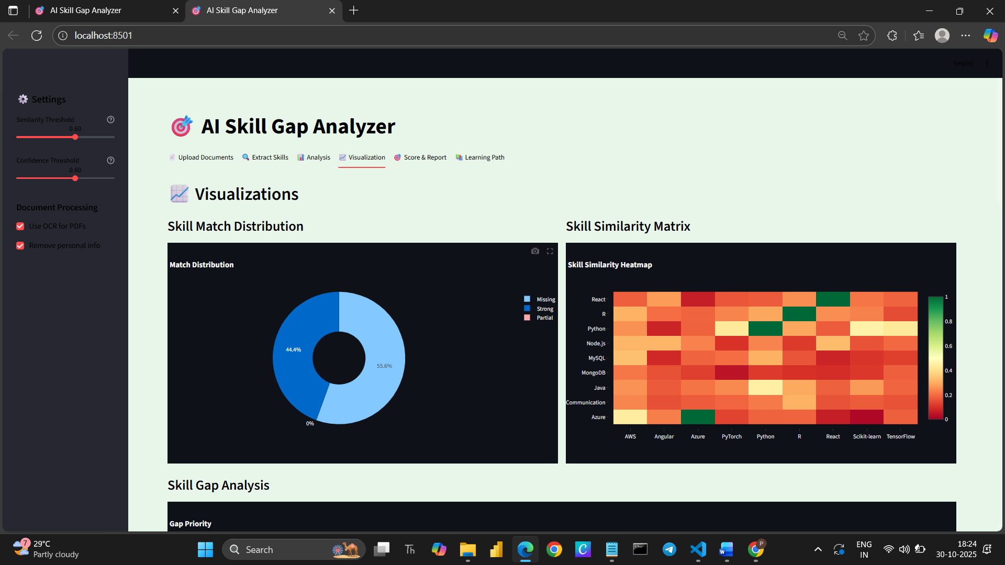

Slide 15
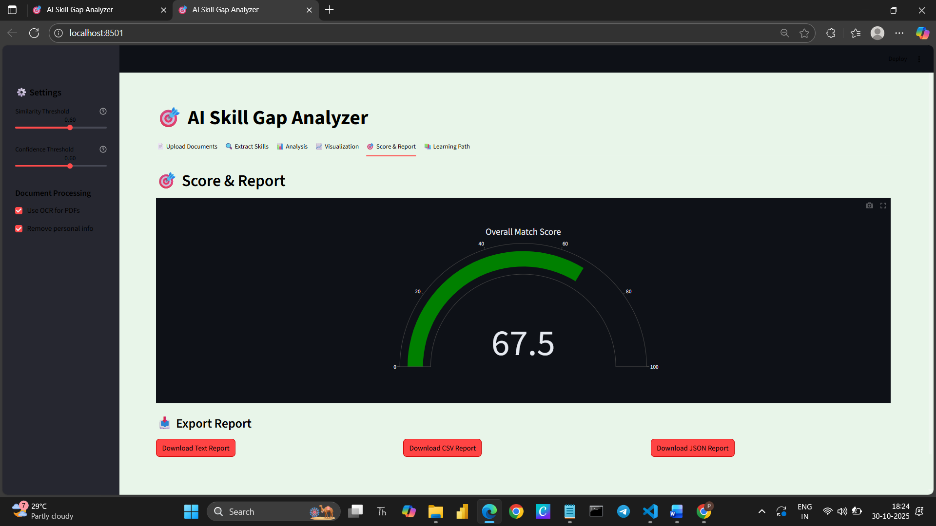
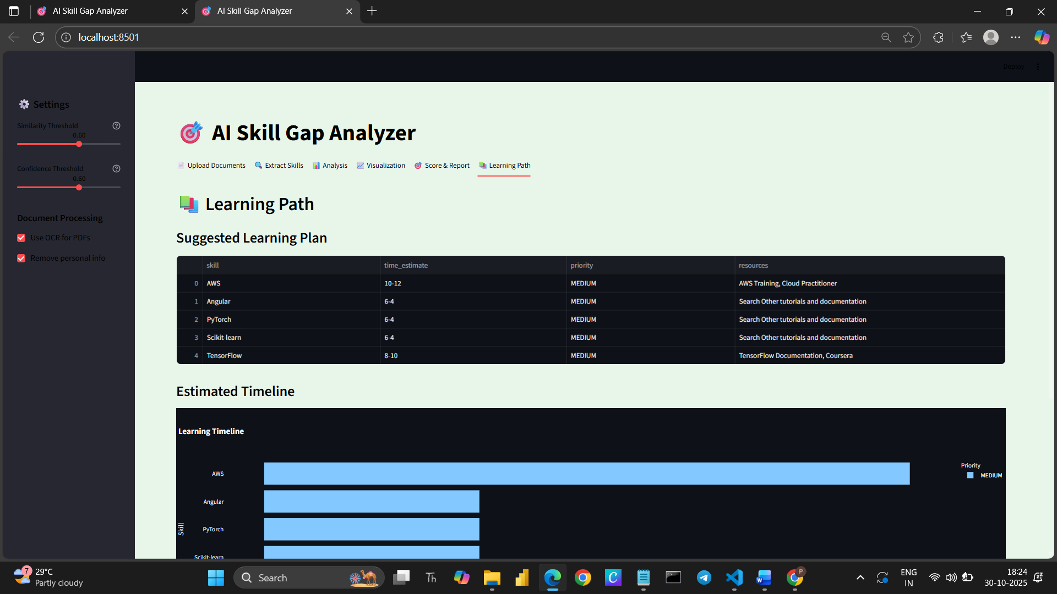

Slide 16

Conclusion
The AI Skill Gap Analyzer successfully demonstrates the integration of Natural Language Processing, Machine Learning, and semantic similarity models for intelligent skill extraction and analysis. This version establishes a strong foundation for building data-driven recruitment tools, personalized learning systems, and workforce planning solutions.it Suggest learning paths or job roles based on detected skill gaps.

Slide 17

Thank You
Priya Poosaala

